Slide 1
End-to-End Object Detection and Recognition in
Forward-Looking Sonar Images with Convolutional
Neural Networks
Convolutional Neural Network-based Real-time ROV
Detection Using Forward-looking Sonar Image

Slide 2
End-to-End Object Detection
Drawback
Smaller datasets
Less information
CNN-based models
generalize outside of the training set
fine-tuning of the classification layers
Notes:
1.对训练集进行泛化的作用
2.网络层级可以通过微调拟合参数

Slide 3
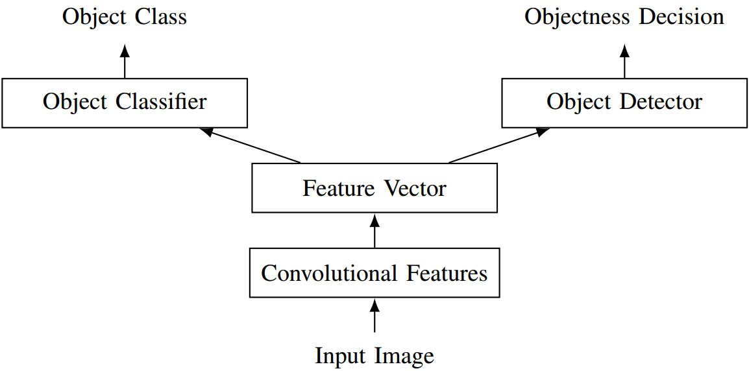
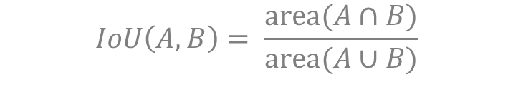
End-to-End Object Detection
Network Architecture
Objectness
objectness scores in the [0, 1] range
$$IoU\left(A,B\right)= \frac{area(A∩B)}{area(A∪B)}$$
Object Class
which class the object belongs to
Notes:
兴趣区域的置信度：A是预测区域，B是预先标记的区域

Slide 4
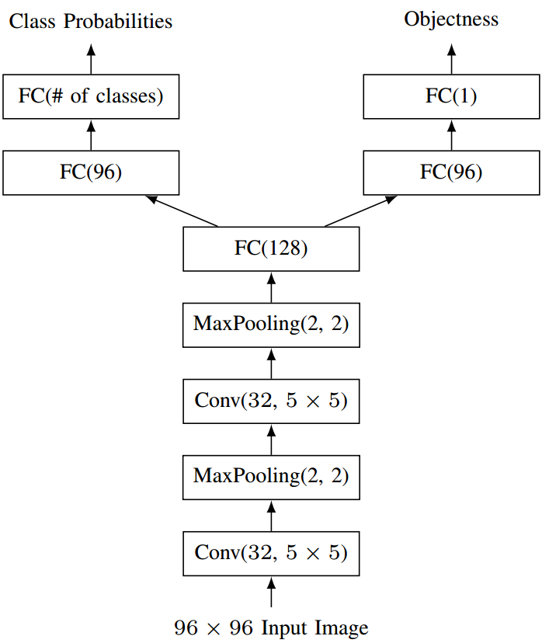
End-to-End Object Detection
Network Architecture
Detection Sub-Network
FC(96)-FC(1)
sigmoid activation
Classification Sub-Network.
FC(96)-FC(Nc)
Softmax function

Slide 5
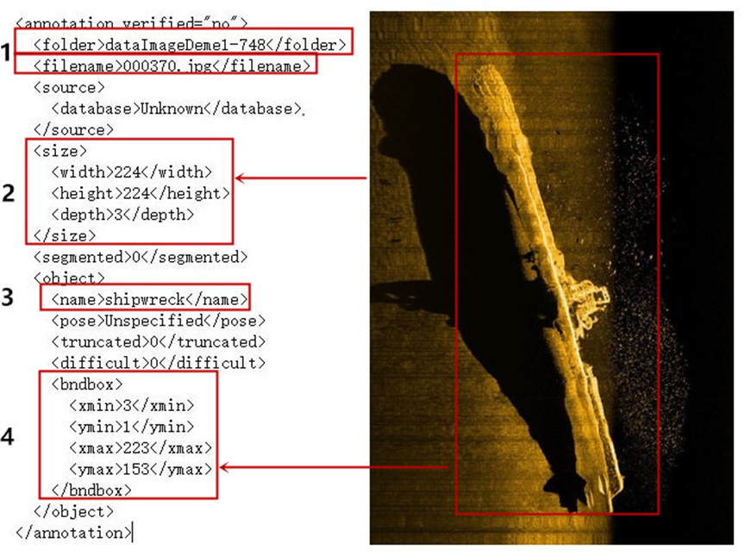
End-to-End Object Detection
Data Preprocessing
Labeled Forward-Looking Sonar Image
bounding boxes
class annotations

Slide 6
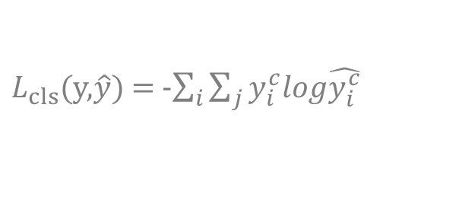

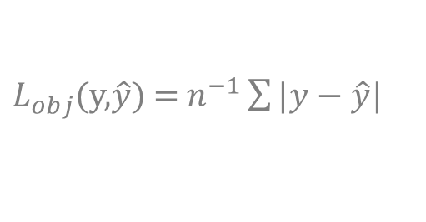
End-to-End Object Detection
Training
Classification
cross-entropy loss
$L_{cls}$(y,$\hat{y}$) = -$\sum_{i}{\sum_{j}{y_{i}^{c}log\hat{y_{i}^{c}}}}$
Objectness
mean absolute error
$L_{obj}$(y,$\hat{y}$) = $n^{−1}\sum{|y−\hat{y}|}$
Fusion
weight calculation
$$L= λL_{cls}+βL_{obj}$$
Notes:
损失函数：
类：softmax 交叉熵
目标定位：平均误差/均方误差

Slide 7
End-to-End Object Detection
Fine-tuning
Images generated by a simple sliding window
Detection proposals generated by thresholding the objectness score
SVM classifier
multiclass linear SVM classifier
Notes:
分类效果较差：原因，训练数据集通过滑动窗口生成，质量较差
预训练（Fine-tuning）效果仍然差，主要还是数据集的原因。
把分类子网络换为多类线性SVM分类器

Slide 8
End-to-End Object Detection
Experiment evaluation
Dataset
2000 FLS images with an ARIS Explorer 3000
9 classes
Ocean Systems Lab’s water tank
157132 training 96 × 96 image crops
2000 original images
67343 validation96 × 96 image crops

Slide 9
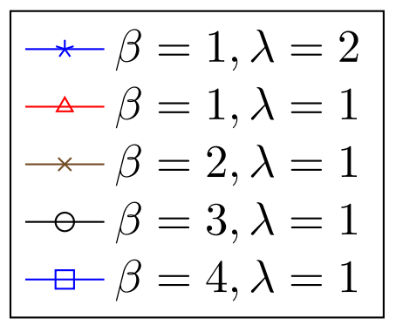
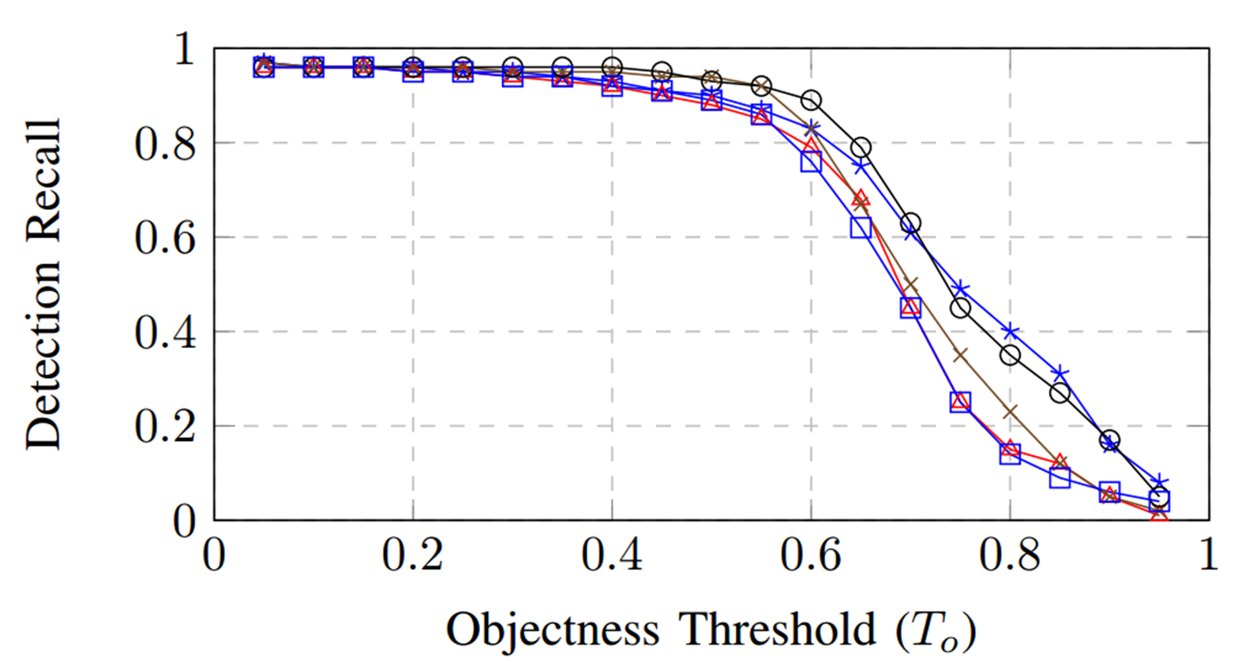
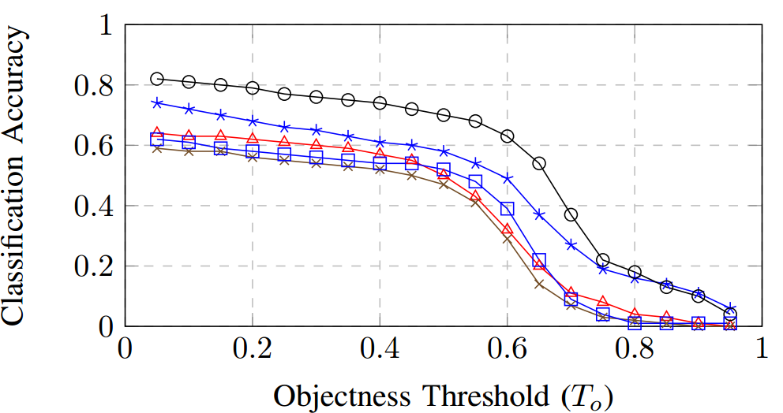
End-to-End Object Detection
Experiment evaluation
result
Quantitative Evaluation
Notes:
首先是定量评价，这里的变量分别是阈值T，两个损失值的权重的关系。
兴趣区域的阈值与召回率和准确率的关系，在0.6的时候下降的比较快，阈值越大说明对于目标物属于前景的要求越高，即目标物的预测框与标记框必须高度重合才能够判定为前景物。

Slide 10
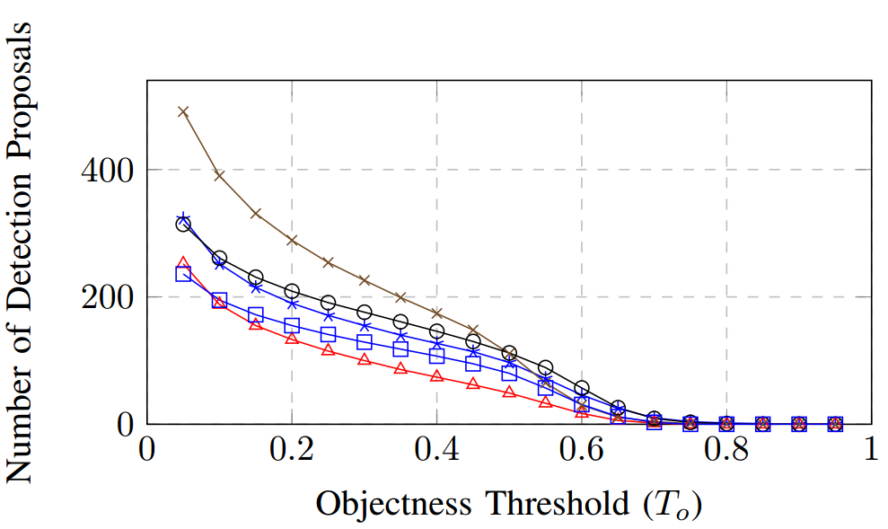
End-to-End Object Detection
Experiment evaluation
result
Quantitative Evaluation
Notes:
这个是阈值和建议区域的数量的关系，随着阈值的增加，符合条件的建议区域就越少

Slide 11
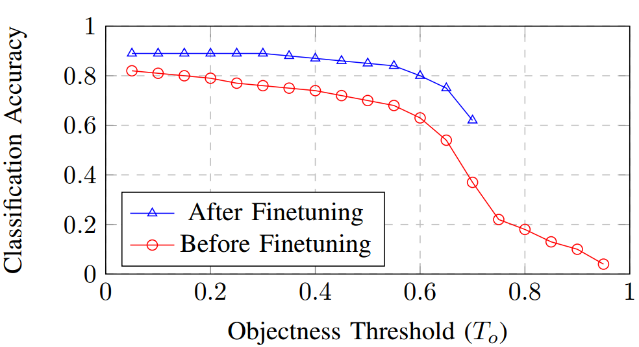
End-to-End Object Detection
Experiment evaluation
result
Fine-Tuning
Notes:
这里是检验了微调的作用，就是我们通常使用的预训练。

Slide 12
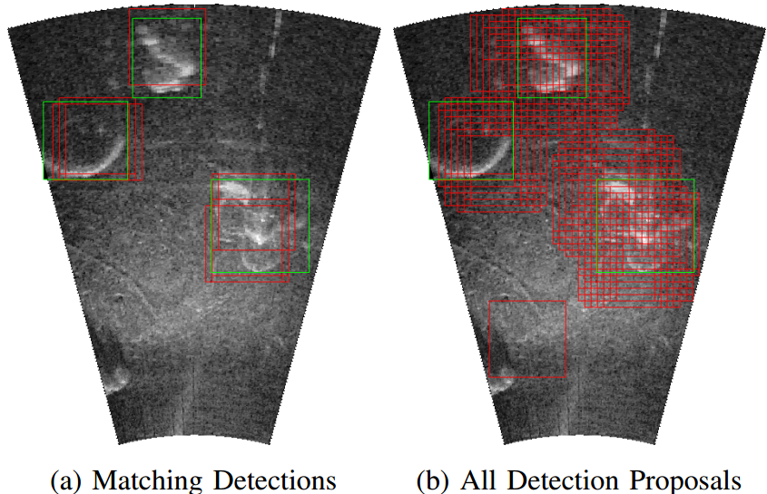
End-to-End Object Detection
Experiment evaluation
result
Qualitative Evaluation
Notes:
定性分析
右边红框是所有检测出来的，0.4的情况下选取的建议区域

Slide 13
End-to-End Object Detection
Conclusion and future work
result
93% recall；75% classification accuracy
Fine-tuning added：85%
future work
multiple scales
dataset

